Slide 1

Prajwal Mohanmurthy, Mississippi State University Medium Energy Physics Group
All I could do with
Ising Model
PH 4433 – Computational Physics
Final Project
Apr 2012
Notes:
Use a section header for each of the topics, so there is a clear transition to the audience.

Slide 2
Outline
Introduction
Heat Capacity in Square, Triangle and Octagonal Lattice
Magnetization in Square, Triangle and Octagonal Lattice
Correlation function for Square Lattice
Block Spin Transformation for Square Lattice
MOVIE!!! (If we have time)
Notes:
This template can be used as a starter file for presenting training materials in a group setting.
Sections
Right-click on a slide to add sections. Sections can help to organize your slides or facilitate collaboration between multiple authors.
Notes
Use the Notes section for delivery notes or to provide additional details for the audience. View these notes in Presentation View during your presentation.
Keep in mind the font size (important for accessibility, visibility, videotaping, and online production)
Coordinated colors
Pay particular attention to the graphs, charts, and text boxes.
Consider that attendees will print in black and white or grayscale. Run a test print to make sure your colors work when printed in pure black and white and grayscale.
Graphics, tables, and graphs
Keep it simple: If possible, use consistent, non-distracting styles and colors.
Label all graphs and tables.

Slide 3
Introduction
1D by Ising (1925), 2D by Onsager (1944)
2 Spins : +/- 1
Done using conventional Monte Carlo using Metropolis Algorithm
For 3 different kind of lattice structure (all are homomorphic, all lattice points are equivalent)
Using Boltzmann statistics
Lattices have periodic boundary continuity
Square Lattice
Triangular Lattice
Moore Lattice
Notes:
If there is relevant video content, such as a case study video, demo of a product, or other training materials, include it in the presentation as well.

Slide 4
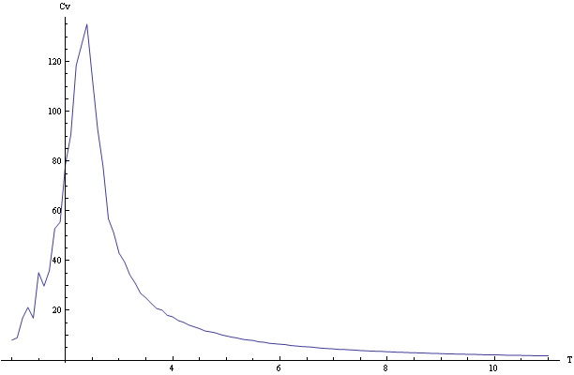
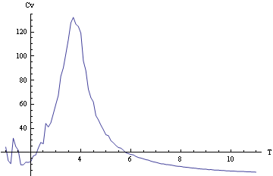
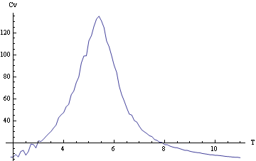
Heat Capacity in Square, Triangle and Octagonal Lattice
Square Lattice (Von Neumann), Tc = 2.2K
Triangle Lattice, Tc = 3.7K
Moore Lattice, Tc = 4.6K
Lattice size of 20X20, T(1,10)
Notes:
Microsoft Engineering Excellence
Microsoft Confidential
4
If there is relevant video content, such as a case study video, demo of a product, or other training materials, include it in the presentation as well.

Slide 5
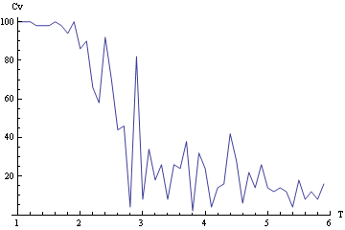
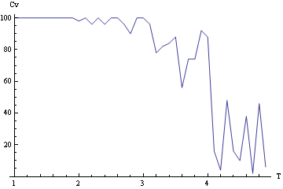
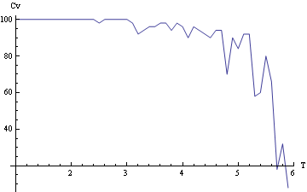
Magnetization in Square, Triangle and Octagonal Lattice
Square Lattice
Triangle Lattice
m
m
Moore Lattice
m
Lattice size of 20X20, T(1,10)
Notes:
Microsoft Engineering Excellence
Microsoft Confidential
5
These are for longitudinally polarized, and up – down asymmetry

Slide 6
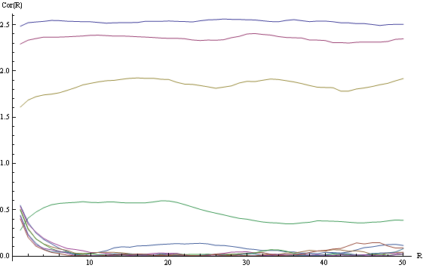
Correlation function for Square Lattice
Lattice size of 100X100, R(1,50), T(1,10)
Notes:
Microsoft Engineering Excellence
Microsoft Confidential
6
If there is relevant video content, such as a case study video, demo of a product, or other training materials, include it in the presentation as well.

Slide 7
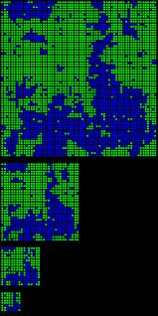
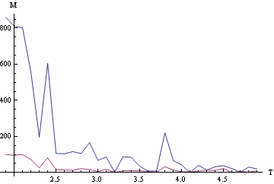
Block Spin Transformation for Square Lattice
Lattice size of 90X90 and blocks of 30X30
Notes:
Microsoft Engineering Excellence
Microsoft Confidential
7
If there is relevant video content, such as a case study video, demo of a product, or other training materials, include it in the presentation as well.

Slide 8
SUMMARY
‘All that happens at T_{c}’
Values of C_{v} diverges at T_{c}
Elbow of the magnetization curve occurs at the T_{c}
Transition from long range correlated system (large scale structure formation) to random system at T_{c}
And finally nothing happens to the value of T_{c} if the lattice is scaled/block transformed.
References
DV. Schroider, An Introduction to Thermal Physics (Chapter 10)
RH Landau, MJ Paez &, CC Bordeianu, A Survey of Computational Physics: Introductory Computational Science

Slide 9
Questions???
Notes:
Microsoft Engineering Excellence
Microsoft Confidential
9
If there is relevant video content, such as a case study video, demo of a product, or other training materials, include it in the presentation as well.

